Slide 1
Eyeballin
Submitted By: Bob’s Bullies
Dane Erosa, Isaac Schultz, Rebecca Rothschild, Tim Borisenko, Kenzo Banaag
Notes:
Nobody since this is just the title slide

Slide 2
Mission Statement
We at EyeBallin, are looking to change the game when it comes to indoor navigation and gps for the visually impaired. Our hope and desire is to help the visually impaired be successful. One of their main problems is there lack of ability to navigate and we are here to solve that.
Our application is voice driven and designed to be a hands free product. Users will be able able to tell their smartphone device a location on one of the four floors at WSU Everett, and our app will generate fast and accurate directions for the user to follow with minimal risk of collision. If the user has an unfortunate fall while navigating through the building, our app will call and text message their immediate emergency contact. Once the user has reached their destination, our device will sound off a chime to end the navigation process.
Notes:
Dane- (Backup Tim)

Slide 3
Our Logo
E
Notes:
Dane and Isaac

Slide 4

Features
Our key marketing features:
Accurate and consistent direction delivery.
Text to speech processing.
Fall detection.
Multi-level floor processing.
Building security notification.
Notes:
(Rebecca)

Slide 5
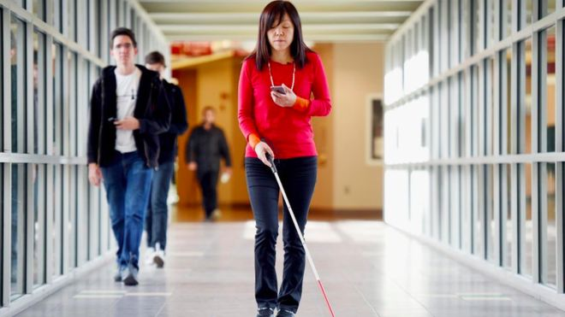
Stakeholders
Visually Impaired
The Development Team
Bolong
Caretakers for the Visually Impaired
WSU Everett Students
Notes:
(Rebecca)

Slide 6

Process Model - Prototyping
Requirement Analysis: Process ended 10/13
Design: 10/14 - 11/12
Implementation: 11/13 - 12/7
Testing: 12/2 - 12/12
Evolution: 12/8 - Present
Notes:
Hello I am in need of some memes in the form of an app for the blind. Thank you. (Rebecca)

Slide 7
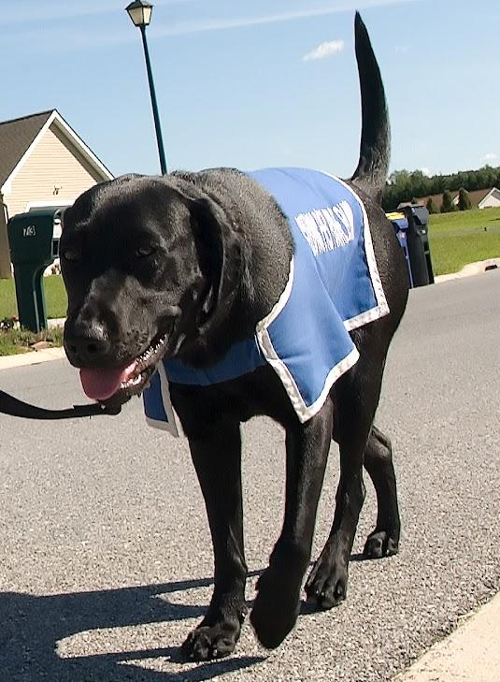
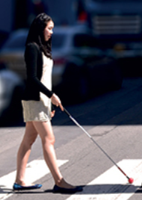

Top Services
Service Dog
White Cane
Path Guide
EyeBallin
E
Notes:
Tim

Slide 8
Creeping Rate Phase I Prediction
Current creep rate:
During the Requirements Specification phase, we added additional functionality for detecting falls, as well as displaying a visual interface to augment the audio interface. A rough estimate would put this at about 10% creep over the month.
Maximum Creep Rate:
We estimate that we would be able to handle about 35% more work over the duration of the project. since we only have about 2 months left to code this project, that would put the maximum creep rate that we can handle at about 15% per month.
Notes:
Isaac. We have capstone projects, and we have other projects that are more important

Slide 9
Creeping Rate Phase II Results
Creep Rate Overall: As the team continues to produce the app after the initial deadline of 12/8, the team could potentially increase the creep rate and add new features/work to the product. However, during the transition from the end of Phase I to the end of Phase II, the team had to restructure the project and the current creep rate is -6.8%.
Maximum Creep Rate Overall: Due to timing and constraints. The teams maximum creep rate would actually be -22%. Mapping obstacles was the main issue in the decrease. The team had to eliminate some features such as object avoidance, and mapping the half of the school where professor’s offices are.
One main feature that we managed to keep in scope was detection of falls.

Slide 10
Original FP’s
 | Simple | Average | Complex
Inputs | 5 | 1 | 1
Outputs | 6 | 32 | 4
Inquiries | 1 | 3 | 0
Files | 0 | 1 | 0
External Interfaces | 1 | 2 | 2

Slide 11
Ending FP’s
 | Simple | Average | Complex
Inputs | 3 | 0 | 2
Outputs | 5 | 32 | 0
Inquiries | 1 | 0 | 0
Files | 0 | 1 | 0
External Interfaces | 1 | 2 | 1

Slide 12
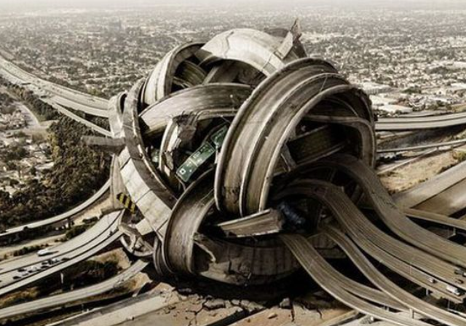
ASS-IS Scenario 1
Alexa TreBecca is usually with a caregiver and a white cane as she walks to class. Her caregiver wasn’t able to make it today, and the classroom she needed to be in was different than the usual one. Alexa asked a stranger to take her to room 258. The stranger thought she said 458 and didn’t confirm with her and took her to the elevator, where she told her the directions to take after getting off. Alexa accidentally got out of the elevator on floor 3, and was late to class after realizing there was nobody else in room 358, which is where she ended up.

Slide 13

To-Be Scenario 1
Alexa TreBecca’s caregiver was out sick another day and she had to navigate WSU Everett to get to her class by herself. She told the app to take her to room 458, which the app then confirmed with her. In the elevator, Alexa accidentally pressed floor 3 instead of 4. when she got out of the elevator EyeBallin notified her that she was on the wrong floor. Alexa was then was able to successfully make it to room 458 in time for class.

Slide 14
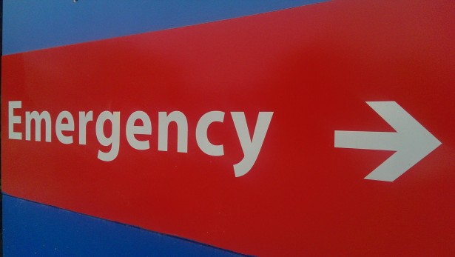
AS-IS Scenario-2
Danezel Washington came out of his study room late in the evening to use the bathroom.
As soon as he walked in, there was a puddle on the ground that he didn’t notice.
He stepped into it, slipped and fell. After about 15 minutes of moaning, security found him and called 911.
Notes:
Isaac

Slide 15


TO-BE Scenario-2
As Danezel usually does, he studies late at school. While he was studying late, he got really hungry and decided to go get some food. While leaving his study room, he trips and falls because someone left a chair in the walkway and was knocked unconscious. EyeBallin immediately called and texted the security personnel working that night and was able to get help immediately.
Notes:
Isaac

Slide 16

AS-IS Scenario-3
Dane Cook has trouble walking in a straight line for longer than a few feet, and often gets lost in the building when he cannot figure out where he is.
Everyday he walks to class using his white cane, and because of this has a hard time getting to class in a timely manner.
Notes:
Kenzo

Slide 17
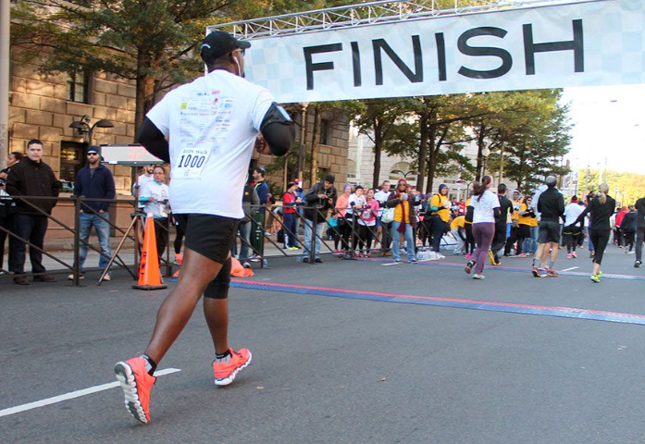
To-Be Scenario 3
Dane Cook got to the WSU Everett building and quickly opened up the EyeBallin app. Told the app he would like to go to room 456. As usual, Dane could not maintain his walking trajectory and went off course, but Eyeballin adjusted the directions, and corrected him.
Dane got to his classes much faster than usual thanks to the EyeBallin app.

Slide 18
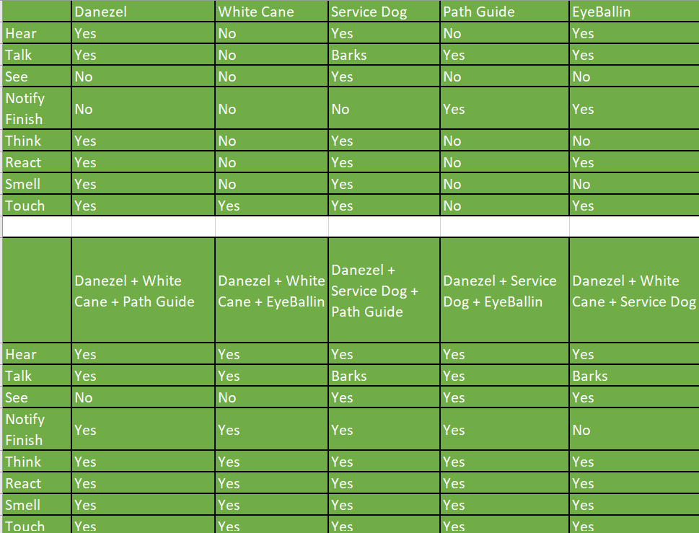
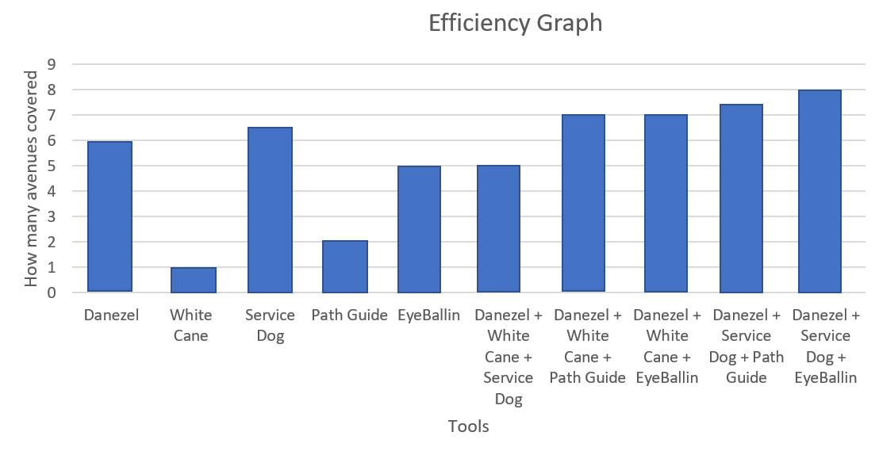
Analytical Comparison
Notes:
(Dane)

Slide 19
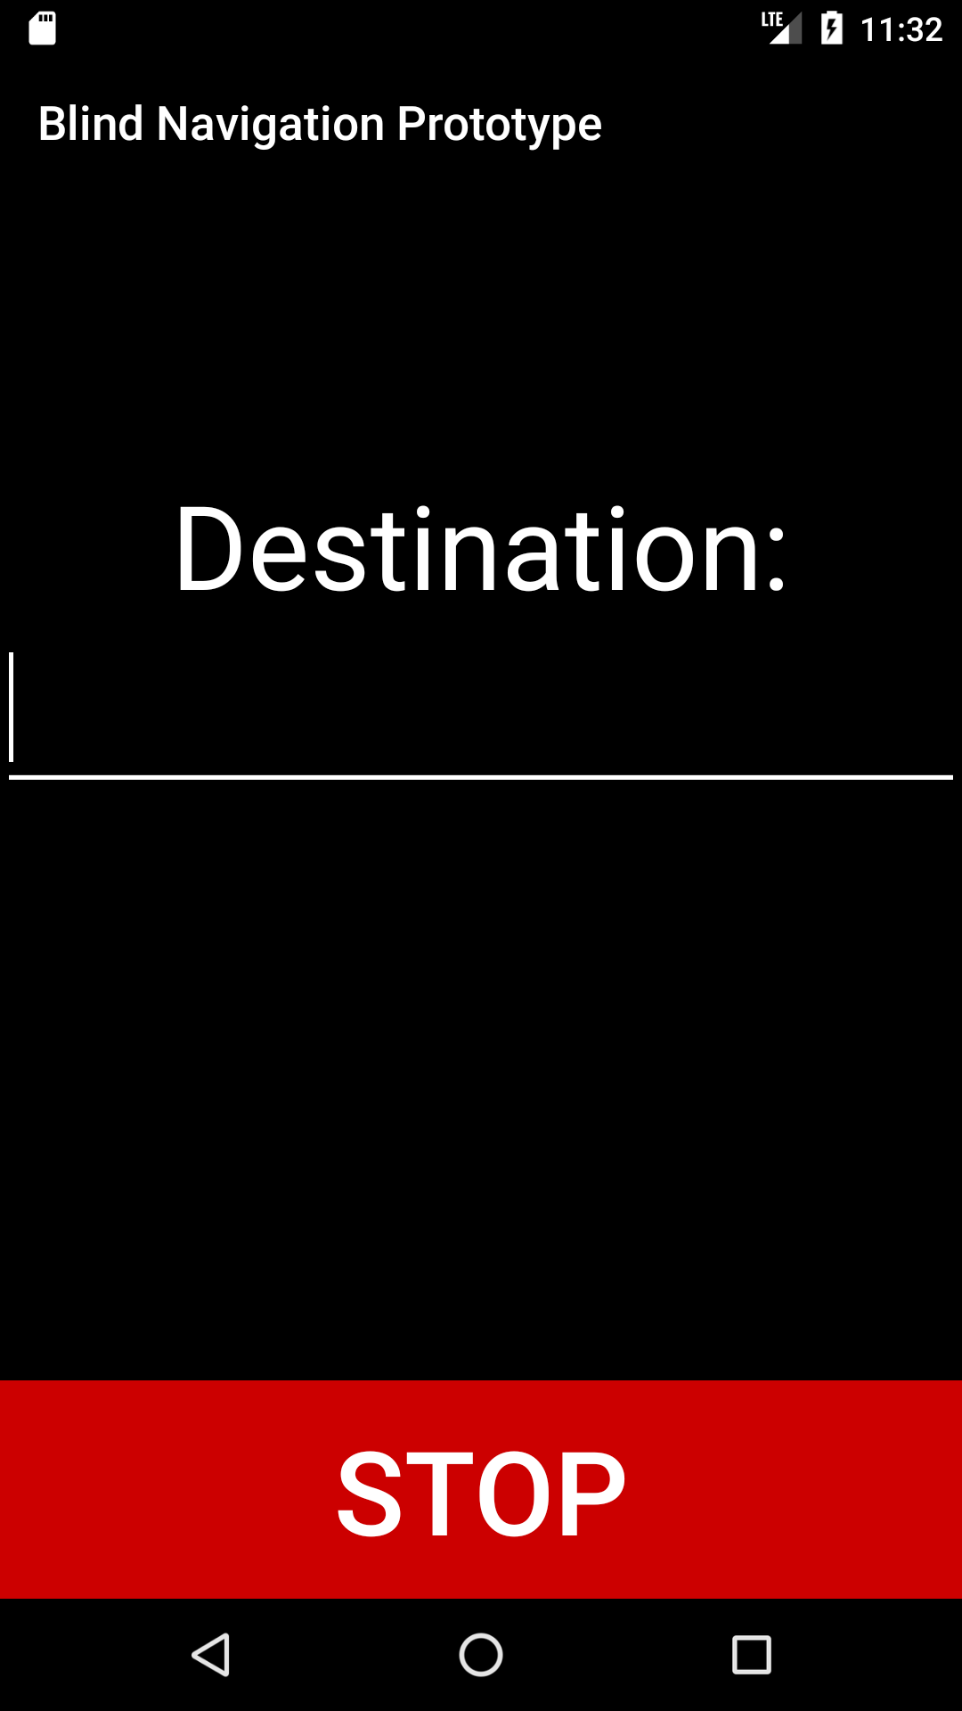
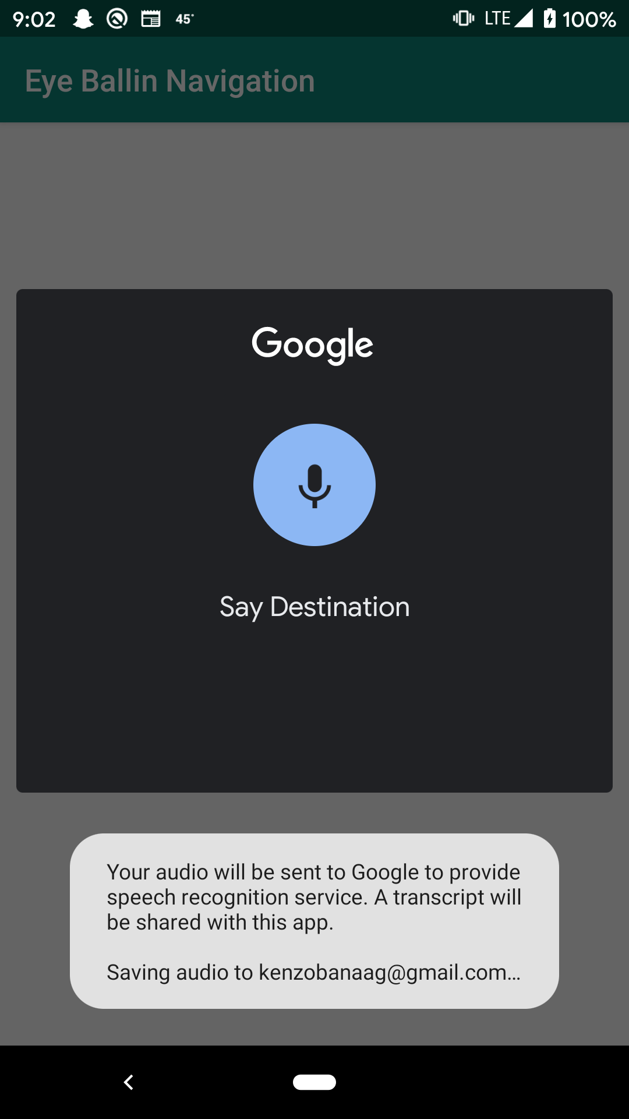
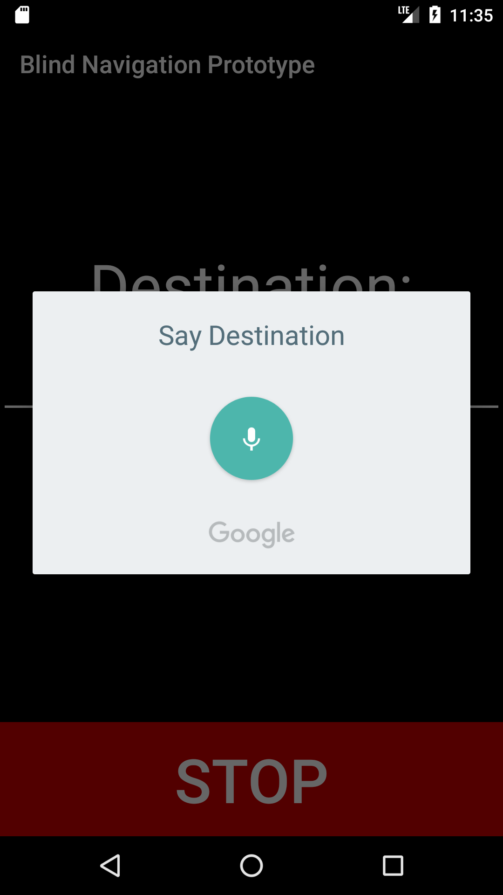
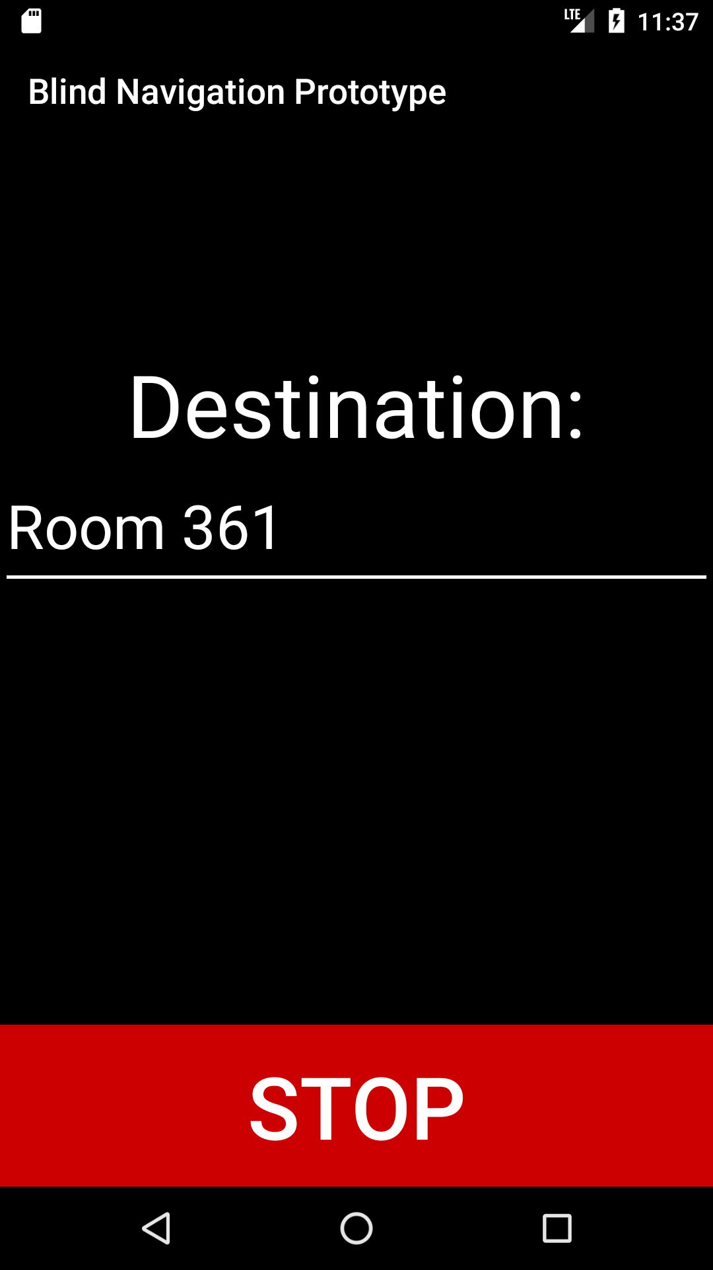
Our Design
App: Hello, please state your destination
App: Going to room 361, is that correct?
User: Room 361
Notes:
Kenzo

Slide 20
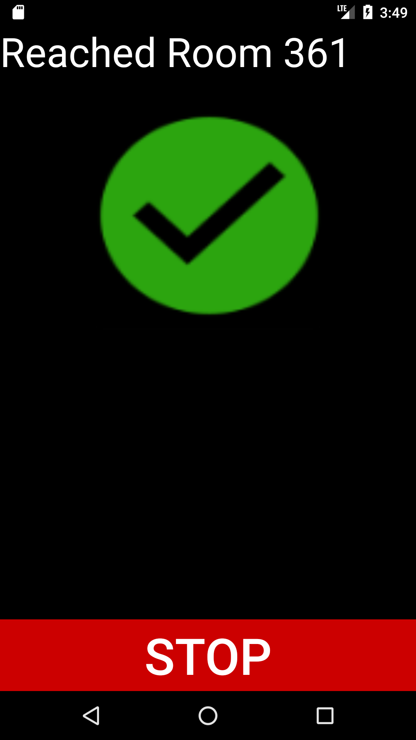
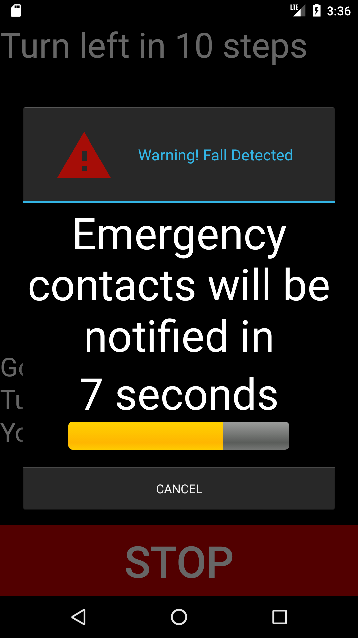
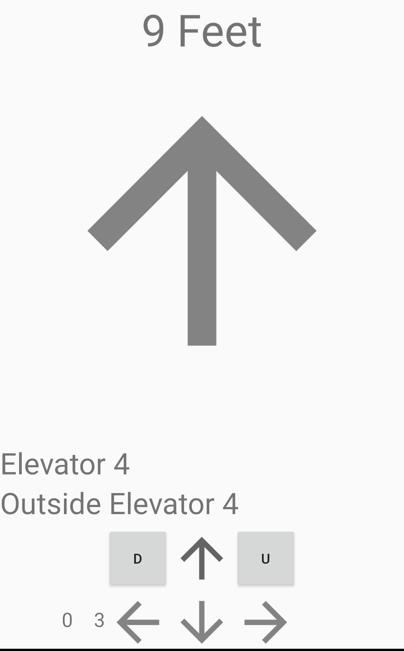
Our Design
App: Fall detected, emergency contacts will be notified in 10 seconds. Say cancel to cancel
App: walk forward 9 feet
App: You have arrived. The door is in front of you.
Notes:
Kenzo

